Slide 1

HIGH PERFORMANCE HARDWARE IMPLEMENTATION OF AES USING MINIMAL RESOURCES
By
Batch No. D12
THEEPIREDDY MANUSHA REDDY 16H55A0441
K S RAHUL 15H51A04L6
ADHIREDDY YESHWANTH REDDY 15H51A04J1
MINI PROJECT COORDINATOR
Mrs. T SWAPNARANI
ASSISSTANT PROFESSOR
DEPARTMENT OF ELECTRONICS & COMMUNICATION ENGINEERING
C.M.R COLLEGE OF ENGINEERING AND TECHNOLOGY
KANDLAKOYA, MEDCHAL ROAD,HYDERABAD-501401

Slide 2
INTRODUCTION
The importance of cryptography is constantly increasing since the amount of sensitive data being transmitted over an open environment is also increasing day by day.
Encryption is usually done just before sending data. To utilize the channel resources completely encryption algorithm must have a speed at least equivalent to data transmission speed.

Slide 3
(Contd.)
The AES (Advanced Encryption Standard) is a computer security standard from NIST (National Institute of Standards and Technology) intended for protecting electronic data in 2001. Later Rijndael algorithm was selected as AES algorithm
Rijndael algorithm (Pronounced as Rine Dael) can have key length of 128, 192 and 256 bits while block size must be 128 bit

Slide 4
OBJECTIVE
Cryptography allows people to carry over the confidence found in the physical world to the electronic world. The importance of cryptography is constantly increasing since the amount of sensitive data being transmitted over an open environment is also increasing day by day.
The amount of information that is transmitted in computer readable form ,the more vulnerable we become to automated spying.
Cryptography is not only important in defense applications but also important in real world applications such as E-commerce, E-mail etc..

Slide 5
EXISTING SYSTEM
The AES is a computer security standard from NIST intended for protecting electronic data. AES use Rijndael algorithm (Pronounced as Rine Dael) by Joan Daeman and Vicent Rijimen for both encryption and decryption.
The AES cryptography algorithm is capable of encrypting and decrypting 128 bit data using cipher keys of 128, 196 or 256 bits.

Slide 6
(Contd.)
Rijndael encryption consist of four operations
1. Substitution
2. Shift Row
3. Mix Column
4. Key Addition
The Rijandael decryption consists of four inverse operations of encryption which are compliment functions of encryption.

Slide 7
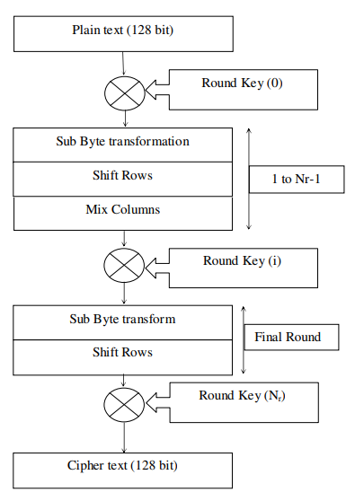
Algorithm for aes encryption

Slide 8
PROPOSED SYSTEM
The proposed architecture is designed to get maximum speed and lesser area by mapping all the four Logical functions of AES to LUTs, ROMs and Block RAMs.
The proposed architecture has three parts
1. Key Generation Module
2. Encryption Module
3. Decryption Module.

Slide 9
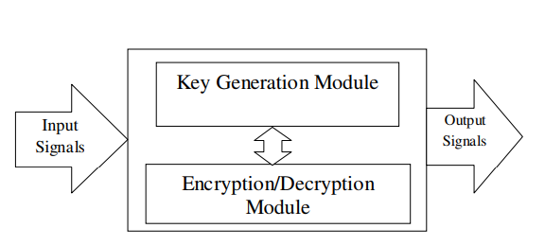
BLOCK DIAGRAM
AES Encryption and Decryption Unit Block Diagram

Slide 10
REQUIREMENTS
Software:
Xilinx ISE
Hardware:
PC

Slide 11
PRINCIPLE OF OPERATION
The AES encryption and decryption core unit contains key generation module as a common unit. This module gives necessary key expansion for both encryption and decryption functions.
The key generation module consists of key register of 128 bits, S-Box and XOR gates for bitwise XOR operation.

Slide 12
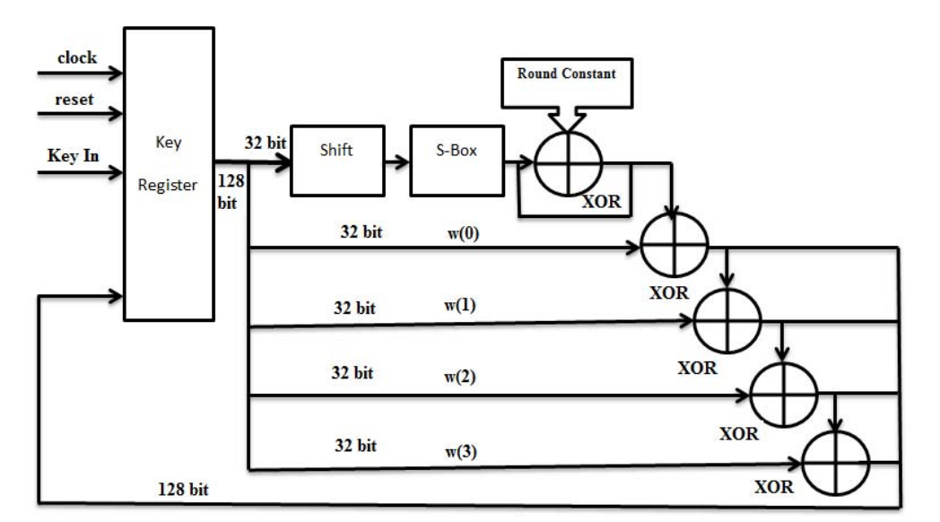
Architecture of Key Generation Module.

Slide 13
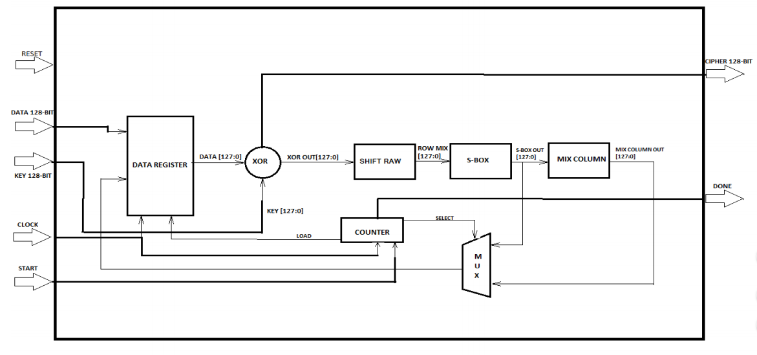
Proposed architecture of encryption module

Slide 14
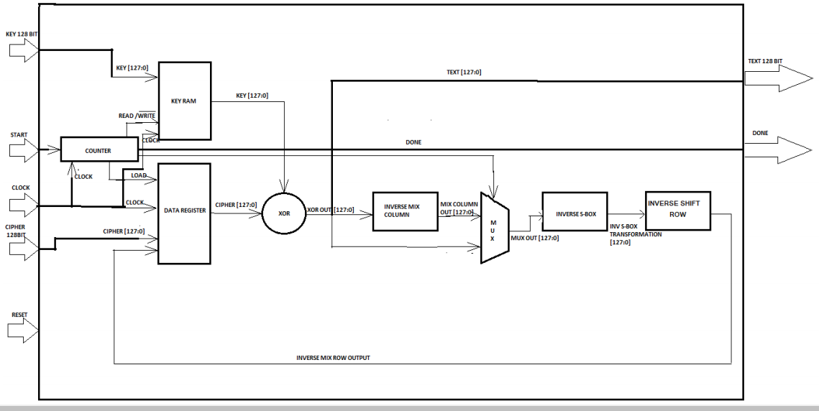
Proposed architecture of Decryption module

Slide 15
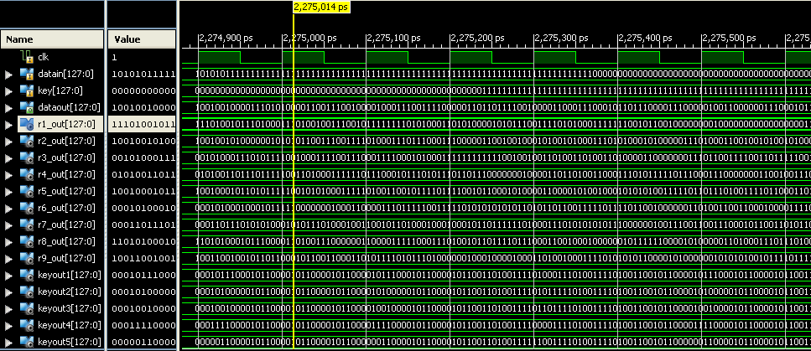
SIMULATION RESULT
Simulation for AES

Slide 16
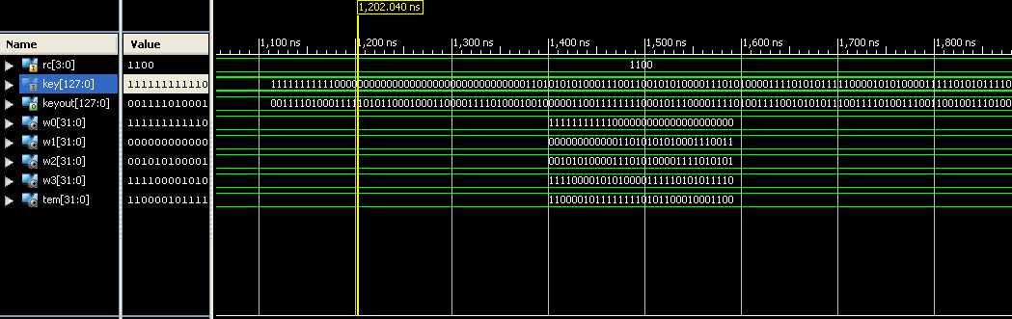
Simulation for Key Expansion

Slide 17
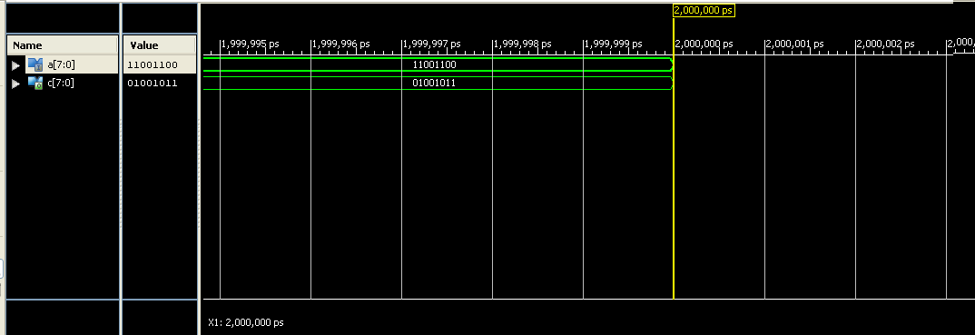
Simulation for AES _SBOX

Slide 18
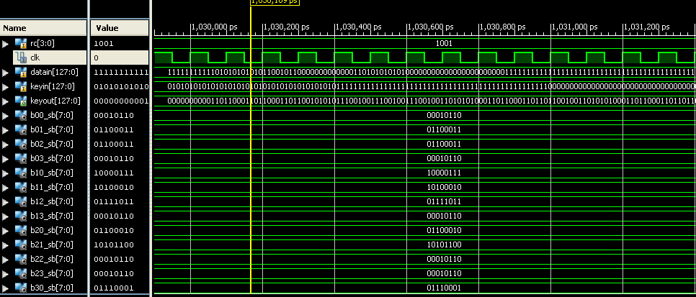
Simulation for Rounds

Slide 19
ADVANTAGES
Requires low space.
Speed of operation is high.
Low power consumption.
Easy to implement.

Slide 20
APPLICATIONS
Widely used for computer and communication network.
Information security has aroused high attention.
Used in military, political and diplomatic fields.
Also applied to common fields of people’s daily lives.

Slide 21
CONCLUSION
The proposed architecture achieves a throughput of 3.74 Gbps and thereby utilizing only 1% of slices in the targeted FPGA.
Since the speed is higher than the already reported systems, hence the proposed design serves as the best high speed encryption algorithm and is thus suitable for various applications. Moreover with less area utilization, the proposed design can be embedded with other larger designs as well.

Slide 22
REFERENCES
1. M. Goswami and S. Kannojiya, “High Performance FPGA Implementation of AES Algorithm with 128-Bit Keys,” Proc. IEEE Int. Conf. Advances Computing Comm., vol. 1, Himarpur, India, 2011, pp. 281-286.
2. FIPS-197, NIST - National Institute of Standards and Technology, “Announcing the ADVANCED ENCRYPTION STANDARD (AES),” http://csrc.nist.gov/publications/fips/fips197/fips-197.pdf, 2001.
3. W. Wei, C. Jie and X. Fei, “An Implementation of AES Algorithm on FPGA,” IEEE 9th Int. Conf. on Fuzzy Systems and Knowledge discover 2012, pp. 1615-1617.

Slide 23
THANK YOU

